Slide 1
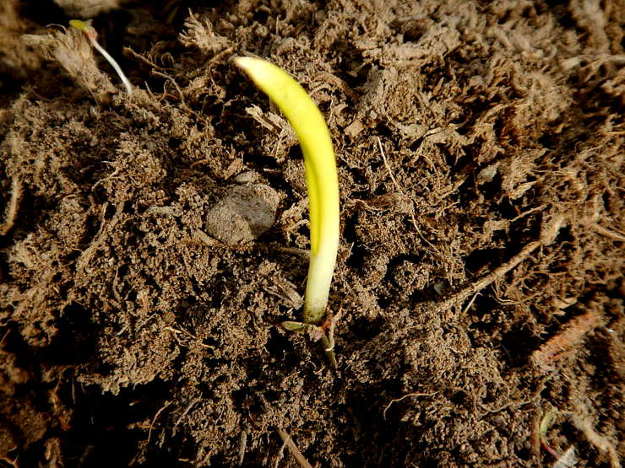
The Renewal of
Your Mind
Practical Lessons on
Being Transformed
Elliotsville Church of Christ
“The Renewal of Your Mind” Series

Slide 2
Romans 12:1-2
Therefore I urge you, brethren, by the mercies of God, to present your bodies a living and holy sacrifice, acceptable to God, which is your spiritual service of worship. And do not be conformed to this world, but be transformed by the renewing of your mind, so that you may prove what the will of God is, that which is good and acceptable and perfect.

Slide 3
Romans 12:1-2
Therefore I urge you, brethren, by the mercies of God, to present your bodies a living and holy sacrifice, acceptable to God, which is your spiritual service of worship. And do not be conformed to this world, but be transformed by the renewing of your mind, so that you may prove what the will of God is, that which is good and acceptable and perfect.

Slide 4
Romans 12:1-2
Therefore I urge you, brethren, by the mercies of God, to present your bodies a living and holy sacrifice, acceptable to God, which is your spiritual service of worship. And do not be conformed to this world, but be transformed by the renewing of your mind, so that you may prove what the will of God is, that which is good and acceptable and perfect.

Slide 5
Romans 12:1-2
Therefore I urge you, brethren, by the mercies of God, to present your bodies a living and holy sacrifice, acceptable to God, which is your spiritual service of worship. And do not be conformed to this world, but be transformed by the renewing of your mind, so that you may prove what the will of God is, that which is good and acceptable and perfect.

Slide 6
Romans 12:1-2
Therefore I urge you, brethren, by the mercies of God, to present your bodies a living and holy sacrifice, acceptable to God, which is your spiritual service of worship. And do not be conformed to this world, but be transformed by the renewing of your mind, so that you may prove what the will of God is, that which is good and acceptable and perfect.

Slide 7
Romans 12:1-2
Therefore I urge you, brethren, by the mercies of God, to present your bodies a living and holy sacrifice, acceptable to God, which is your spiritual service of worship. And do not be conformed to this world, but be transformed by the renewing of your mind, so that you may prove what the will of God is, that which is good and acceptable and perfect.

Slide 8
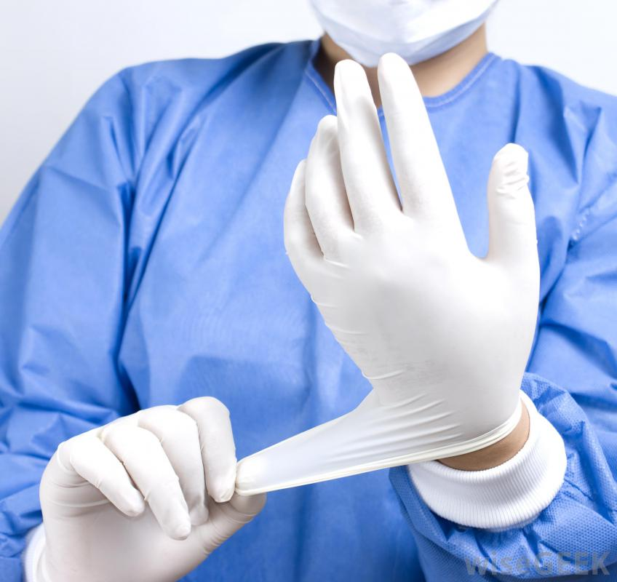
Can You Operate?
Regaining Active Christianity
Elliotsville Church of Christ – 02/19/2016
“The Renewal of Your Mind” Series

Slide 9
Modern Christianity
We Have Become Lazy in Our Christianity
We List Attributes or Things We Don’t Do as Proof of Holiness
We are Called to be Active Christians
This Involves Real, Living, Transformative Change and Action in Our Lives

Slide 10
Symptoms of Weak Faith
We Misunderstand the Lists of Attributes Given in the New Testament

Slide 11
2 Peter 1:5-8
Now for this very reason also, applying all diligence, in your faith supply moral excellence, and in your moral excellence, knowledge, and in your knowledge, self-control, and in your self-control, perseverance, and in your perseverance, godliness, and in your godliness, brotherly kindness, and in your brotherly kindness, love. For if these qualities are yours and are increasing, they render you neither useless nor unfruitful in the true knowledge of our Lord Jesus Christ.

Slide 12
Symptoms of Weak Faith
We Misunderstand the Lists of Attributes Given in the New Testament
2 Peter 1:5-7
We Have Become Obsessed with Talking About Being Holy

Slide 13
James 2:14-17
What use is it, my brethren, if someone says he has faith but he has no works? Can that faith save him? If a brother or sister is without clothing and in need of daily food, and one of you says to them, “Go in peace, be warmed and be filled,” and yet you do not give them what is necessary for their body, what use is that? Even so faith, if it has no works, is dead, being by itself.

Slide 14
Symptoms of Weak Faith
We Misunderstand the Lists of Attributes Given in the New Testament
2 Peter 1:5-7
We Have Become Obsessed with Talking About Being Holy
James 2:14-17
We Focus on the Soil Without Trying to Produce Fruit

Slide 15
Matthew 7:17-20
So every good tree bears good fruit, but the bad tree bears bad fruit. A good tree cannot produce bad fruit, nor can a bad tree produce good fruit. Every tree that does not bear good fruit is cut down and thrown into the fire. So then, you will know them by their fruits.

Slide 16
Symptoms of Weak Faith
We Misunderstand the Lists of Attributes Given in the New Testament
2 Peter 1:5-7
We Have Become Obsessed with Talking About Being Holy
James 2:14-17
We Focus on the Soil Without Trying to Produce Fruit
Matthew 7:17-20

Slide 17
Gaining an Active Faith
Christ Viewed Discipleship as an Active Commitment

Slide 18
Matthew 16:24-27
Then Jesus said to His disciples, “If anyone wishes to come after Me, he must deny himself, and take up his cross and follow Me. For whoever wishes to save his life will lose it; but whoever loses his life for My sake will find it. For what will it profit a man if he gains the whole world and forfeits his soul? Or what will a man give in exchange for his soul?”

Slide 19
Gaining an Active Faith
Christ Viewed Discipleship as an Active Commitment
Matthew 16:24-27
We are Called to be Alive and Active in Our Faith

Slide 20
Revelation 3:1-2
To the angel of the church in Sardis write: He who has the seven spirits of God and the seven stars, says this: “I know your deeds, that you have a name that you are alive, but you are dead. Wake up, and strengthen the things that remain, which were about to die, for I have not found your deeds completed in the sight of My God.”

Slide 21
Gaining an Active Faith
Christ Viewed Discipleship as an Active Commitment
Matthew 16:24-27
We are Called to be Alive and Active in Our Faith
Revelation 3:1-2
Pure and Undefiled Religion is Active

Slide 22
James 1:22-27
But prove yourselves doers of the word, and not merely hearers who delude themselves…But one who looks intently at the perfect law, the law of liberty, and abides by it, not having become a forgetful hearer but an effectual doer, this man will be blessed in what he does. If anyone thinks himself to be religious, and yet does not bridle his tongue but deceives his own heart, this man’s religion is worthless. Pure and undefiled religion in the sight of our God and Father is this: to visit orphans and widows in their distress, and to keep oneself unstained by the world.

Slide 23
Gaining an Active Faith
Christ Viewed Discipleship as an Active Commitment
Matthew 16:24-27
We are Called to be Alive and Active in Our Faith
Revelation 3:1-2
Pure and Undefiled Religion is Active
James 1:22-27

Slide 24
Undergoing Radical Change
If We Live for Christ, that Means Changing and Growing

Slide 25
2 Corinthians 5:16-17
Therefore from now on we recognize no one according to the flesh; even though we have known Christ according to the flesh, yet now we know Him in this way no longer. Therefore if anyone is in Christ, he is a new creature; the old things passed away; behold, new things have come.

Slide 26
Undergoing Radical Change
If We Live for Christ, that Means Changing and Growing
2 Corinthians 5:16-17
The Scriptures are Our Guidebook to Self-Improvement

Slide 27
Acts 17:11-12
Now [the Bereans] were more noble-minded than those in Thessalonica, for they received the Word with great eagerness, examining the scriptures daily to see whether these things were so. Therefore many of them believed, along with a number of prominent Greek men and women.

Slide 28
Undergoing Radical Change
If We Live for Christ, that Means Changing and Growing
2 Corinthians 5:16-17
The Scriptures are Our Guidebook to Self-Improvement
Acts 17:11-12
We Need to Stop Thinking So Much and Listen to God

Slide 29
Hebrews 11:8-10
By faith Abraham, when he was called, obeyed by going out to a place which he was to receive for an inheritance; and he went out, not knowing where he was going. By faith he lived as an alien in the land of promise, as in a foreign land, dwelling in tents with Isaac and Jacob, fellow heirs of the same promise; for he was looking for the city which has foundations, whose architect and builder is God.

Slide 30
Undergoing Radical Change
If We Live for Christ, that Means Changing and Growing
2 Corinthians 5:16-17
The Scriptures are Our Guidebook to Self-Improvement
Acts 17:11-12
We Need to Stop Thinking So Much and Listen to God
Hebrews 11:8-10

Slide 31
Can You Operate?
Christianity is Not Merely a Check-List of Attributes
Christianity is Active, Alive, and Purposeful
If We Don’t Consciously Pursue an Active Life, We Won’t Change at All
If We Don’t Transform, We’ll Never Fulfill the Purpose We Long For

Slide 32
Matthew 25:26-28
But his master answered and said to him, “You wicked, lazy slave, you knew that I reap where I did not sow and gather where I scattered no seed. Then you ought to have put my money in the bank, and on my arrival I would have received my money back with interest. Therefore take away the talent given to him, and give it to the one with ten talents.

