Slide 4
Hebrew
Roman

Slide 5
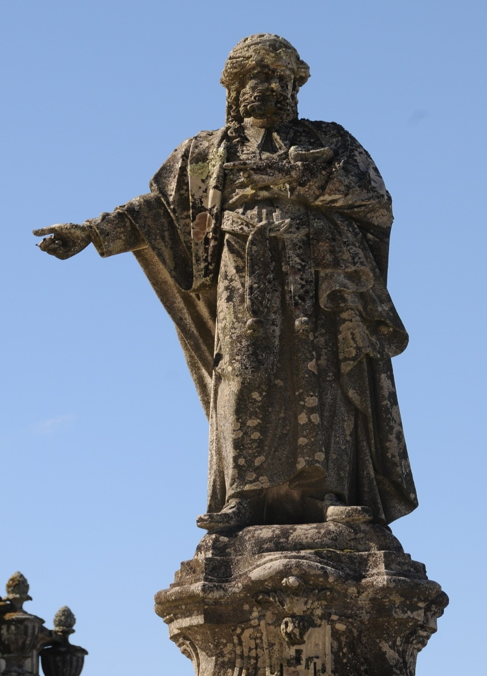
Annas
John 18:12-13 – “¹²So the Roman cohort and the commander and the officers of the Jews, arrested Jesus and bound Him, ¹³and led Him to Annas first; for he was father-in-law of Caiaphas, who was high priest that year.”
Annas, son of Seth (6–15)
Eleazar, son of Annas (16–17)
Joseph, son of Caiaphas (18–36)
Married the daughter of Annas
Jonathan, son of Annas (36–37, 44)
Theophilus, son of Annas (37–41)
Matthias, son of Annas (43)
Ananus, son of Annas (63)

Slide 6
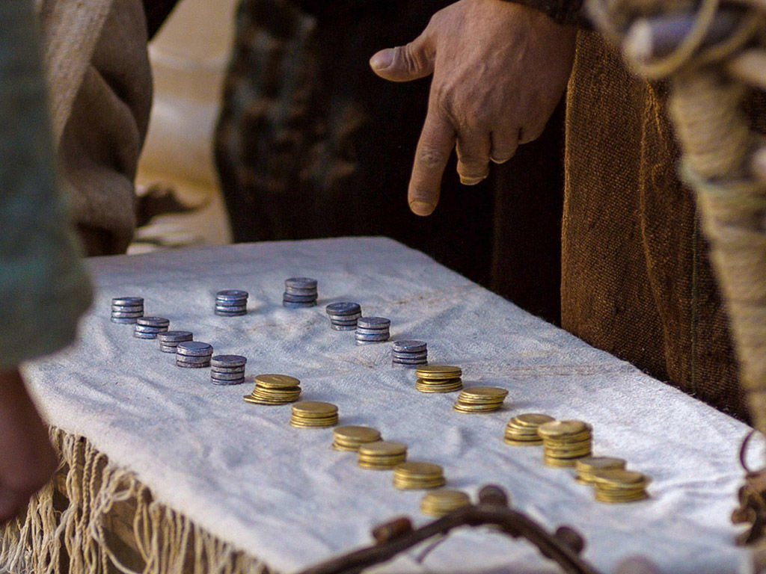
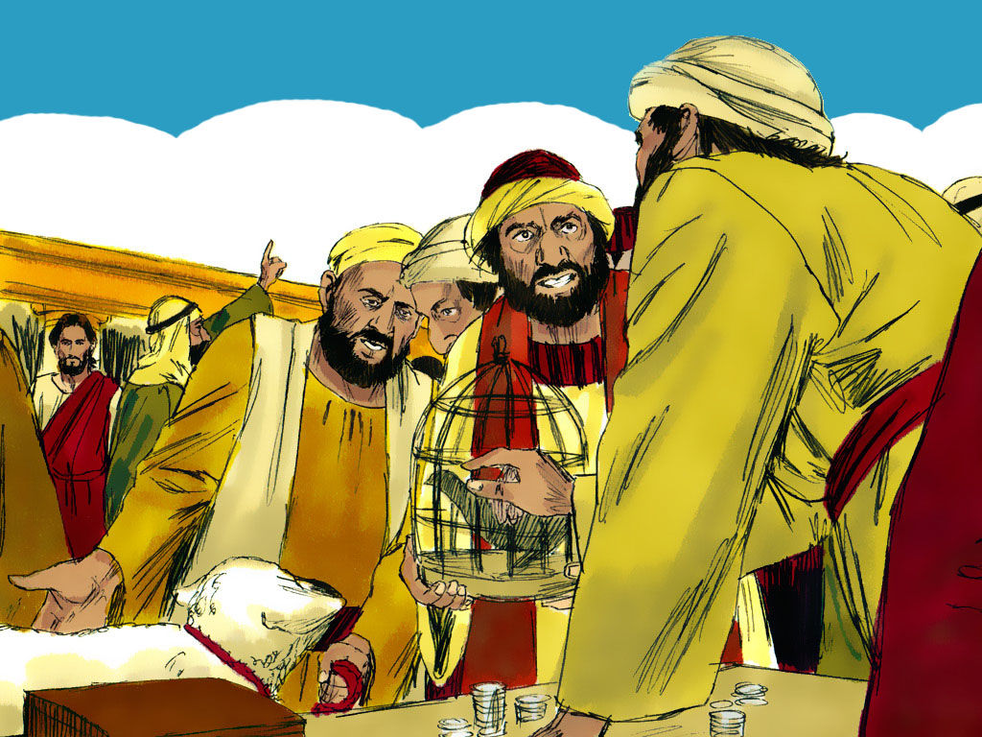
Annas
John 2:13-16 – “The Passover of the Jews was near, and Jesus went up to Jerusalem. And He found in the temple those who were selling oxen and sheep and doves, and the money changers seated at their tables. And He made a scourge of cords, and drove them all out of the temple, with the sheep and the oxen; and He poured out the coins of the money changers and overturned their tables; and to those who were selling the doves He said, ‘Take these things away; stop making My Father’s house a place of business.’”

Slide 7
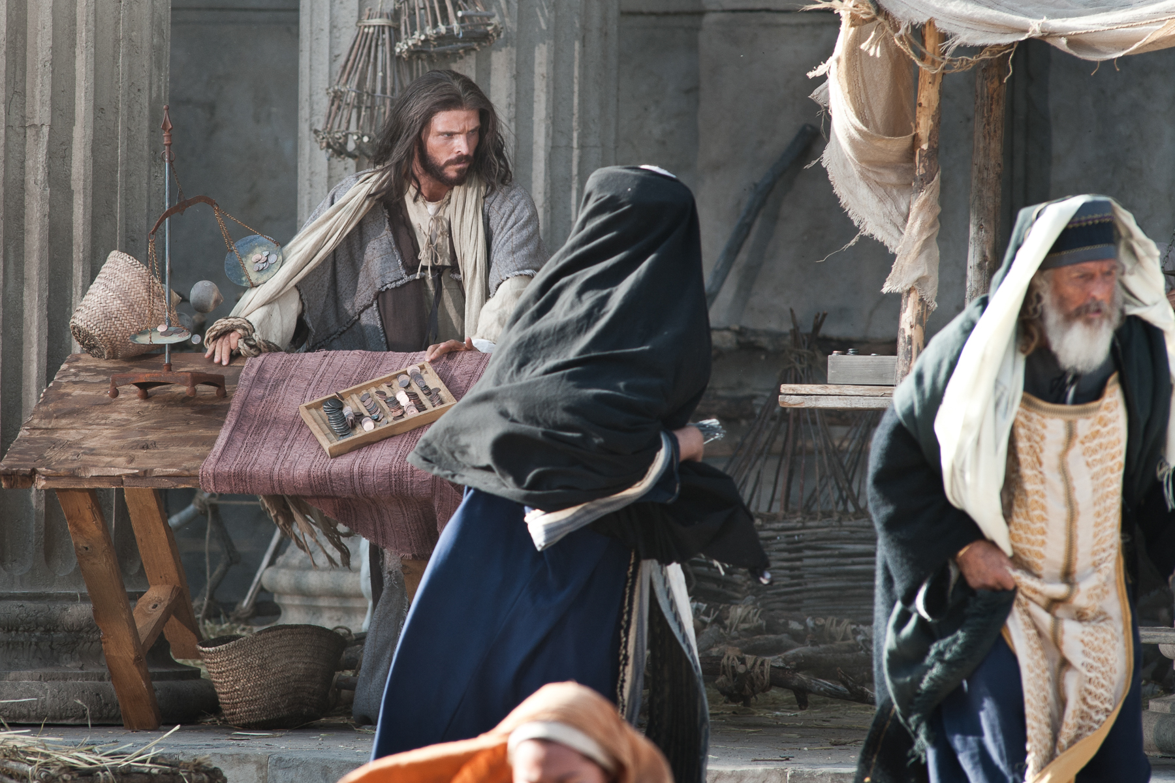
Annas
Matt 21:12-13 – “And Jesus entered the temple and drove out all those who were buying and selling in the temple, and overturned the tables of the money changers and the seats of those who were selling doves. And He said to them, ‘It is written, “My house shall be called a house of prayer”; but you are making it a robbers’ den.’”

Slide 8
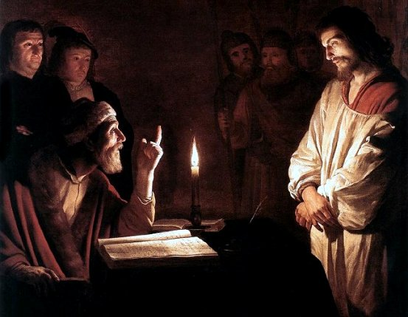
Annas
John 18:19 – “The high priest then questioned Jesus about His disciples, and about His teaching.”
John 18:20-21 – “I have spoken openly to the world; I always taught in synagogues and in the temple, where all the Jews come together; and I spoke nothing in secret. Why do you question Me? Question those who have heard what I spoke to them; they know what I said.”

Slide 9
Annas
Deut 19:15 – “A single witness shall not rise up against a man on account of any iniquity or any sin which he has committed; on the evidence of two or three witnesses a matter shall be confirmed.”

Slide 10
Annas
John 18:22 – “When He had said this, one of the officers standing nearby struck Jesus, saying, ‘Is that the way You answer the high priest?’”
John 18:23 – “Jesus answered him, ‘If I have spoken wrongly, testify of the wrong; but if rightly, why do you strike Me?’”

Slide 11
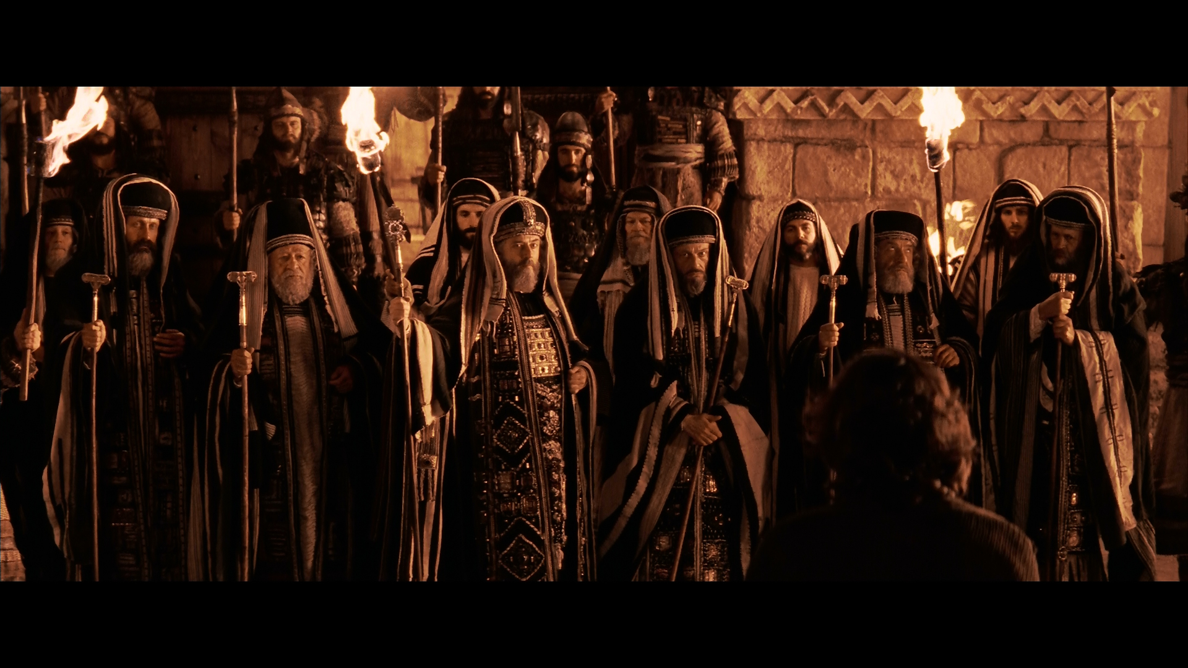
Caiaphas
Mark 14:53 – “They led Jesus away to the high priest; and all the chief priests and the elders and the scribes gathered together.”

Slide 12
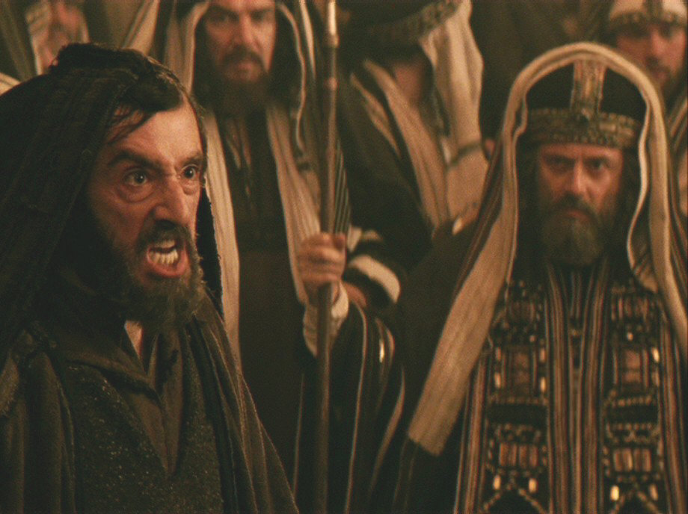
Caiaphas
Mark 14:55 – “Now the chief priests and the whole Council kept trying to obtain testimony against Jesus to put Him to death, and they were not finding any.”
Mark 14:56 – “For many were giving false testimony against Him, but their testimony was not consistent.”

Slide 13
Caiaphas
Deut 19:16-20 – “¹⁶If a malicious witness rises up against a man to accuse him of wrongdoing, ¹⁷then both the men who have the dispute shall stand before the Lord, before the priests and the judges who will be in office in those days. ¹⁸The judges shall investigate thoroughly, and if the witness is a false witness and he has accused his brother falsely, ¹⁹then you shall do to him just as he had intended to do to his brother. Thus you shall purge the evil from among you. ²⁰The rest will hear and be afraid, and will never again do such an evil thing among you.”

Slide 14
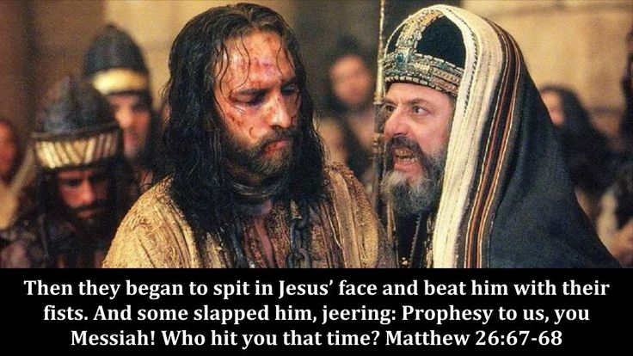
Caiaphas
Matt 26:62-63 – “The high priest stood up and said to Him, ‘Do You not answer? What is it that these men are testifying against You?’ But Jesus kept silent. And the high priest said to Him, ‘I adjure You by the living God, that You tell us whether You are the Christ, the Son of God.’”

Slide 15
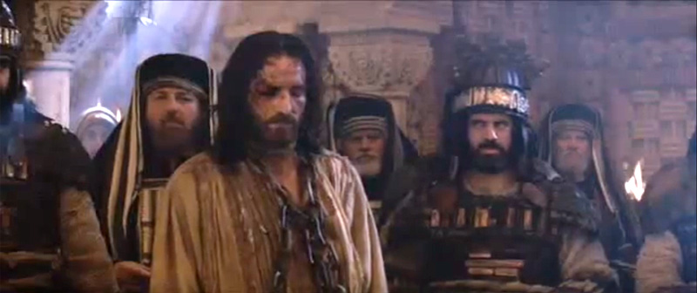
Caiaphas
Matt 26:64 – “Jesus said to him, ‘You have said it yourself; nevertheless I tell you, hereafter you will see the Son of Man sitting at the right hand of Power, and coming on the clouds of heaven.’”

Slide 16
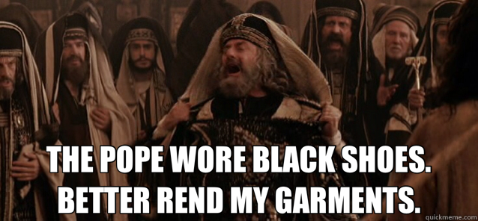
Caiaphas
Matt 26:65-66 – ‘”Then the high priest tore his robes and said, ‘He has blasphemed! What further need do we have of witnesses? Behold, you have now heard the blasphemy; what do you think?’ They answered, ‘He deserves death!’”

Slide 17
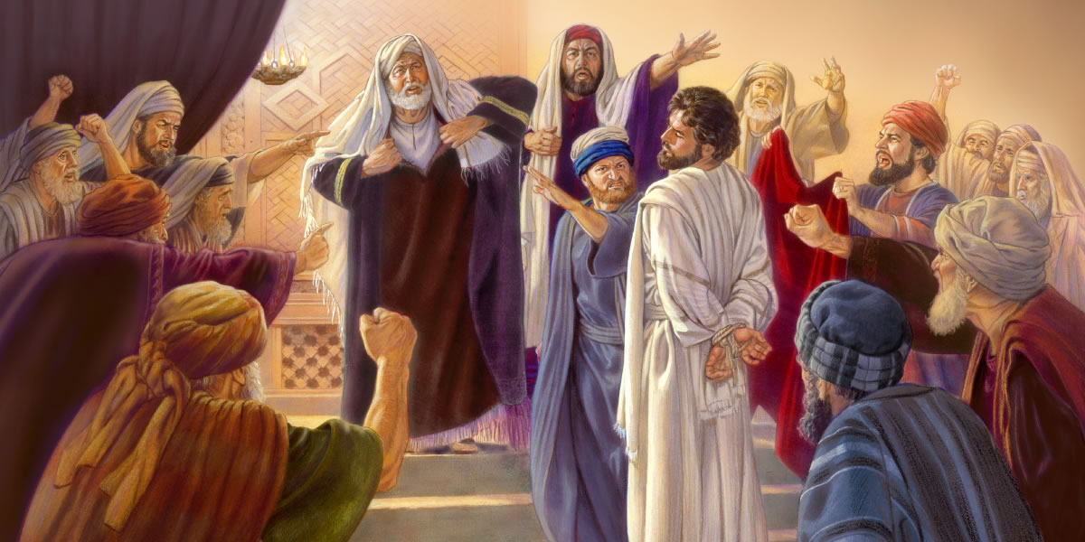
Caiaphas
Matt 26:67-68 – “Then they spat in His face and beat Him with their fists; and others slapped Him, and said, ‘Prophesy to us, You Christ; who is the one who hit You?’”

Slide 18
Sanhedrin
Deut 16:18-20 – “You shall appoint for yourself judges and officers in all your towns which the Lord your God is giving you, according to your tribes, and they shall judge the people with righteous judgment. You shall not distort justice; you shall not be partial, and you shall not take a bribe, for a bribe blinds the eyes of the wise and perverts the words of the righteous. Justice, and only justice, you shall pursue, that you may live and possess the land which the Lord your God is giving you.”
Great
Sanhedrin
Lesser Sanhedrin
Lesser Sanhedrin
Lower Tribunal
Lower Tribunal
Lower Tribunal

Slide 19
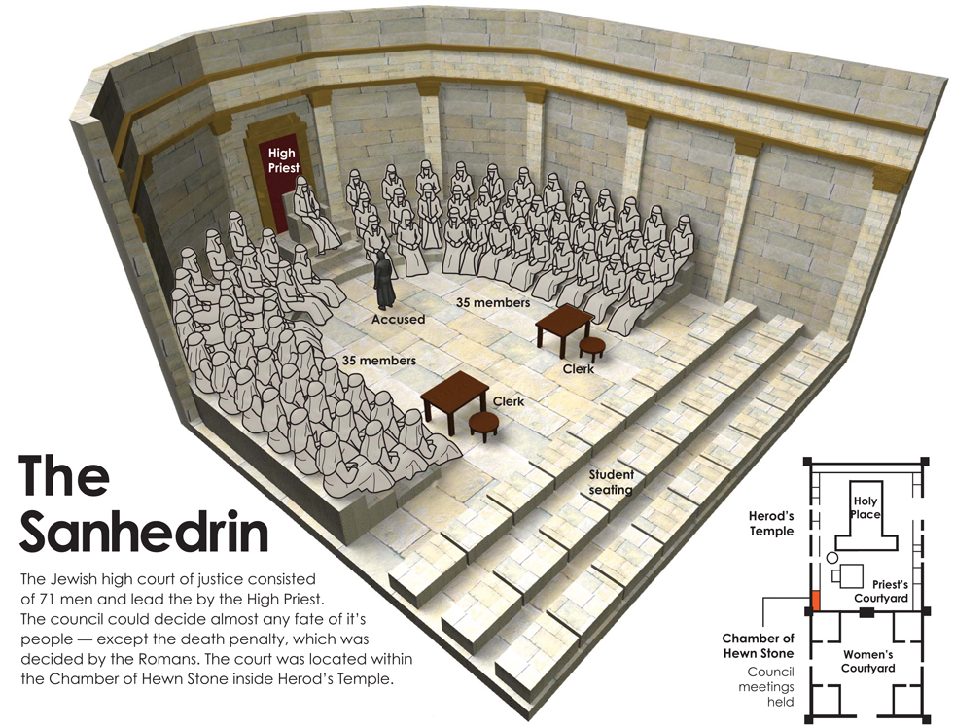
Sanhedrin

Slide 20
Sanhedrin
Guarantees
A Public Trial
The Right of Self Defense
Evidence of 2 or 3 Witnesses

Slide 21
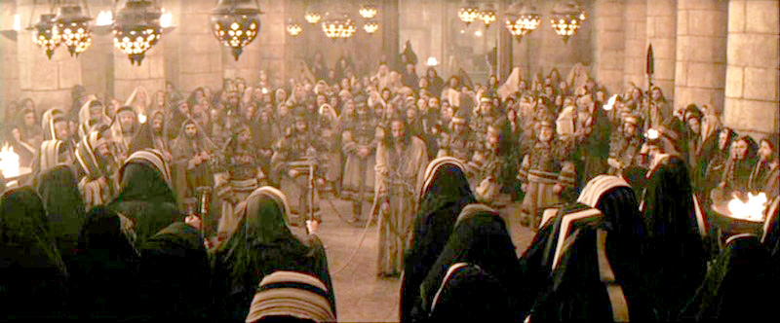
Sanhedrin
Luke 22:66 – “When it was day, the Council of elders of the people assembled, both chief priests and scribes, and they led Him away to their council chamber…”

Slide 22
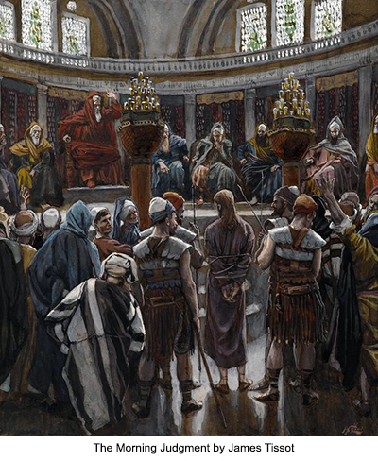
Sanhedrin
Luke 22:67a – “If You are the Christ, tell us.”
Luke 22:67b-69 – “If I tell you, you will not believe; and if I ask a question, you will not answer…
…but from now on the Son of Man will be seated at the right hand of the power of God.’”

Slide 23
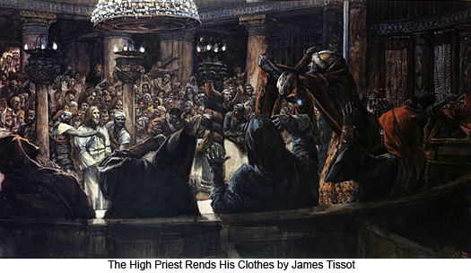
Sanhedrin
Luke 22:70a – “And they all said, ‘Are You the Son of God, then?’”
Luke 22:70b-71 – “And He said to them, ‘Yes, I am.’ Then they said, ‘What further need do we have of testimony? For we have heard it ourselves from His own mouth.’”

Slide 24
Jewish Illegalities
Accused cannot be compelled to testify against himself
“We have it as a fundamental principle of our jurisprudence that no one can bring an accusation against himself. Should a man make confession of guilt before a legally constituted tribunal, such confession is not to be used against him…our law never condemns on the simple confession of an accused party.” (Mishnah, Sanhedrin, ch. vi, #2. , Maimonides Sanhedrin)
2 or 3 witnesses were required to convict
Deut 17:6; 19:15
“The judge shall address each witness as follows: It is not conjecture, or anything you may have heard, that we ask of you…If you should cause the accused to condemned unjustly, his blood shall cry for vengeance against you, and God will hold you accountable, even as he did Cain for the blood of his brother Abel.” (Mishnah, Sanhedrin, ch. iv, #5)
“If one witness contradicts another, the testimony is not accepted.” (Mishnah Sanhedrin, ch. v, #2., Maimonides Sanhedrin ch. xx)
Forbidden to convene between the evening and morning sacrifice
“Let it be tried during the day and suspended at night.” (Mishnah, Sanhedrin, ch. iv, #1)
“The reason why the trial of a capital offense could not be held at night is because a more thorough and searching examination can be made by daylight.” (Maimonides, Sanhedrin, ch. iii)
“The Sanhedrin sat from the close of the morning sacrifice to the time of the evening sacrifice.” (Talmud Jerusalem, Sanhedrin, ch. i, folio 19; Talmud Babylonian ch. x, folio 88; also Mishnah Thamid ch. iii)

Slide 25
Jewish Illegalities
Accused must be treated humanely
The expression of the judge toward the accused must be humane, and even kind, treating him with gentleness and respect. (Mishnah, Sotah, ch. i, #4)
Proceedings must be held in the Chamber of Hewn Stones
“After leaving the hall of hewn stones, no sentence of death can be passed against anyonesoever.” (Talmud Babyl. Abodah Zarah ch. i, folio 8, recto.)
“A sentence of death can be pronounced only so long as the Sanhedrin hold it sessions in the appointed place.” (Maimonides Sanhedrin ch. xiv.)
A quorum (23 of 71 members) required to try a capital case
“If twelve acquit and eleven condemn, he is acquitted.” (Mishnah, Sanhedrin, ch. v, #4a)
“If twelve condemn and eleven acquit, or if eleven condemn and eleven acquit and one says, I do not know, or even if twenty-two acquit or condemn and a single one says, I do not know, they add to the judges.” (Mishnah, Sanhedrin, ch. v, #4b)
No proceedings on Sabbaths, feast days, or on their eves
“Court must not be held on the Sabbath, or any holy day.” (Mishnah, Betza, ch. v, #2)
“They shall not judge on the eve of the Sabbath-day, nor on that of any festival” (Mishnah, Sanhedrin, ch. iv, #1)

Slide 26
Jewish Illegalities
Sanhedrin could not originate charges nor witness against the accused
"The Sanhedrin could not originate charges; it could only investigate those brought before it" (Edersheim in, "Life and times of Jesus the Messiah" Vol. I. p.309)
"The only prosecutors were the witnesses in the crime. The witnesses constituted the charge. There was no formal indictment until these witnesses spoke in the public assembly. When they spoke, and the evidence of two agreed together, it formed the legal charge, libel, or indictment." (Mendelsohn in "The Criminal Jurisprudence of the Ancient Hebrews," p.110)
Deut 19:16-17
Prejudiced judges not allowed to proceed over a trial
"There must not be on the judicial bench either a relation, or a particular friend, or an enemy of either the accused or the accuser" (Mendelsohn in "Criminal Jurisprudence of the Ancient Hebrews" p. 108).
"Nor under any circumstances was a man known to be at enmity with the accused person permitted to occupy a position among his judges" (Benny in "Criminal Code of the Jesus" p. 37).
The accused cannot be condemned on his own confession
“We have it as a fundamental principle of our jurisprudence that no one can bring an accusation against himself. Should a man make confession of guilt before a legally constituted tribunal, such confession is not to be used against him…our law never condemns on the simple confession of an accused party.” (Mishnah, Sanhedrin, ch. vi, #2. , Maimonides Sanhedrin)

Slide 27
Jewish Illegalities
No rending of garments
Lev 21:10 – “The priest who is the highest among his brothers, on whose head the anointing oil has been poured and who has been consecrated to wear the garments, shall not uncover his head nor tear his clothes”
Balloting must be taken from most junior to most senior member
Each judge must have the freedom to vote independently, and by a simple “I absolve” or “I condemn” (Mishnah, Sanhedrin, ch. v, #5)
“Let the judges, each in his turn, absolve or condemn” (Sanhedrin, xv, #5)
A unanimous verdict of guilty had the same effect as an acquittal
“A simultaneous and unanimous verdict of guilt rendered on the day of the trial has the effect of an acquittal.” (Mendelsohn, The Criminal Jurisprudence of the Ancient Hebrews, p. 141.)
“If none of the judges defend the culprit, i.e., all pronounce him guilty, having no defender in the court, the verdict of guilty was invalid and the sentence of death could not be executed.” (Rabbi Wise, The Martyrdom of Jesus, p. 74.)
If the death sentence is pronounced, a 2nd trial is to be held the next day
“A criminal case resulting in the acquittal of the accused may terminate the same day on which it began. But if a sentence of death is to be pronounced, it cannot be conducted before the following day.” (Mishna, Sanhedrin“, ch. iv, #1)

Slide 28
Pompey
Imperator
81–48 B.C.
Child
Marriage
Julius Caesar
Dictator
48–44 B.C.
Appointed
Adopted
Livia
Augustus Caesar
Emperor
31 B.C. – A.D 14
Adopted
Tiberius Caesar
Emperor, A.D. 14–37
(forced to divorce Vispania to marry Julia)
Julia
Claudia
(father was a Roman soldier)
Pontius Pilate
Procurator of Judea
A.D. 26–36

Slide 29
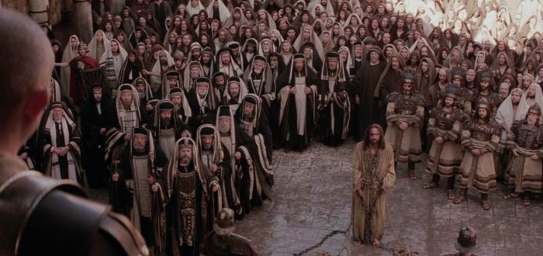
Pontius Pilate
Luke 23:1 – “Then the whole body of them got up and brought Him before Pilate.”
John 18:28 – “Then they led Jesus from Caiaphas into the Praetorium, and it was early; and they themselves did not enter into the Praetorium so that they would not be defiled, but might eat the Passover.”

Slide 30
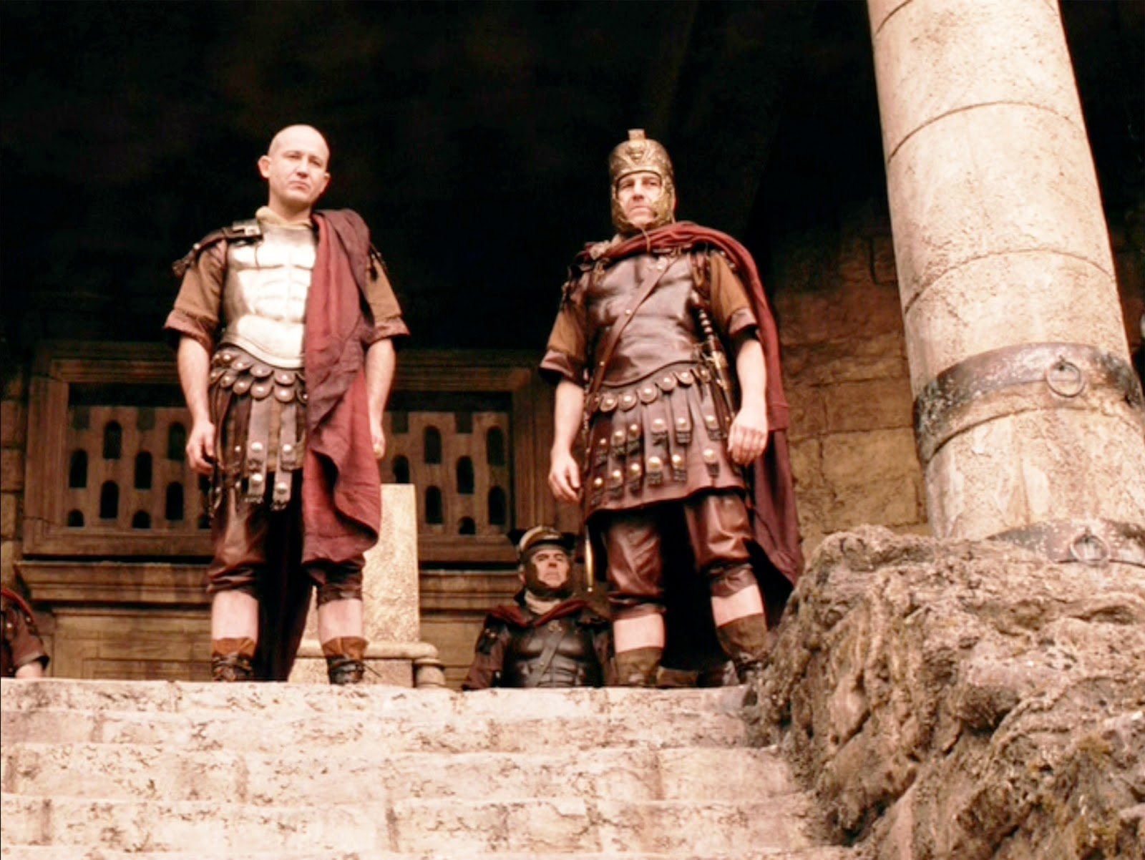
Pontius Pilate
John 18:29-30 – “Therefore Pilate went out to them and said, ‘What accusation do you bring against this Man?’ They answered and said to him, ‘If this Man were not an evildoer, we would not have delivered Him to you.’”
John 18:31 – “So Pilate said to them, ‘Take Him yourselves, and judge Him according to your law.’ The Jews said to him, ‘We are not permitted to put anyone to death.’”

Slide 31
Pontius Pilate
Stages to a Roman Trial
Accusation
Inquiry
Judgment

Slide 32
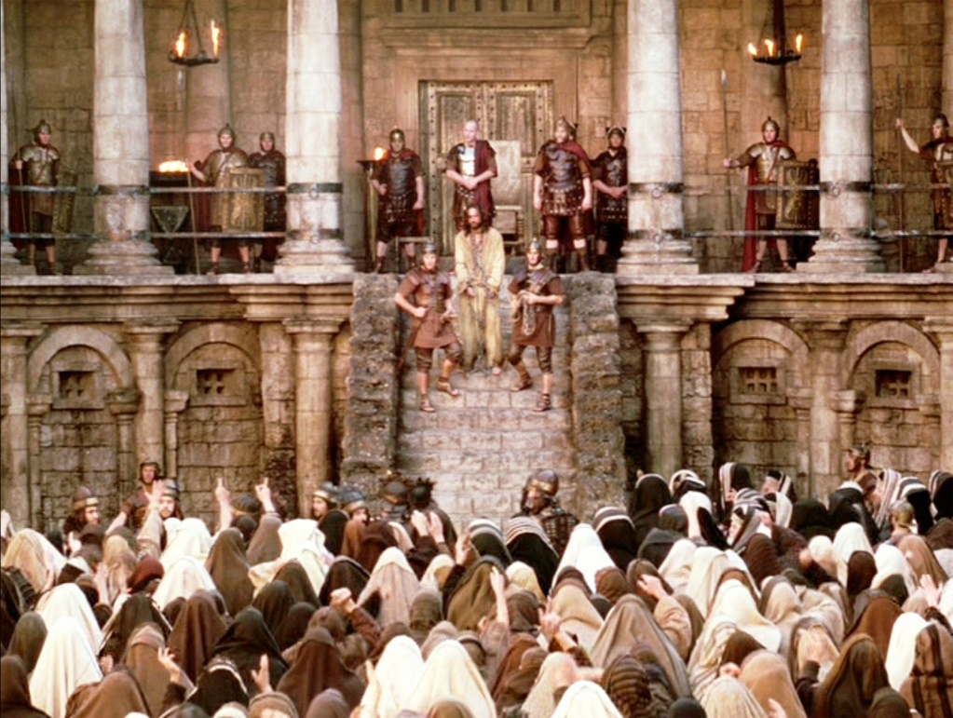
Pontius Pilate
Luke 23:2 – “And they began to accuse Him, saying, ‘We found this man misleading our nation and forbidding to pay taxes to Caesar, and saying that He Himself is Christ, a King.’”
Accusation
Inquiry
Judgment

Slide 33
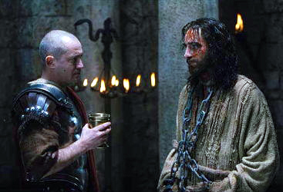
Pontius Pilate
John 18:33 – “Therefore Pilate entered again into the Praetorium, and summoned Jesus and said to Him, ‘Are You the King of the Jews?’”

Slide 34
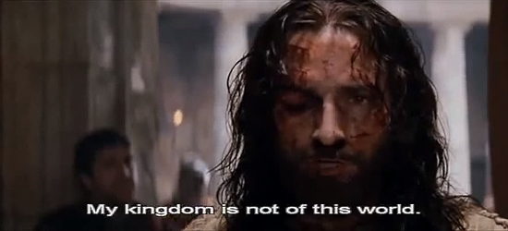
Pontius Pilate
John 18:34 – “Jesus answered, ‘Are you saying this on your own initiative, or did others tell you about Me?’”

Slide 35
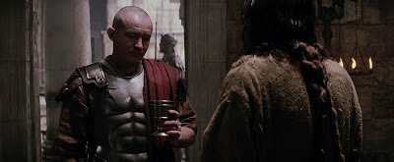
Pontius Pilate
John 18:35 – “Pilate answered, ‘I am not a Jew, am I? Your own nation and the chief priests delivered You to me; what have You done?’”

Slide 36
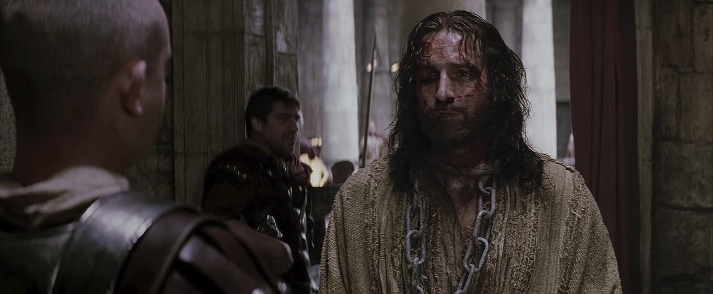
Pontius Pilate
John 18:36 – “Jesus answered, ‘My kingdom is not of this world. If My kingdom were of this world, then My servants would be fighting so that I would not be handed over to the Jews; but as it is, My kingdom is not of this realm.’”

Slide 37
Pontius Pilate
John 18:37 – “Therefore Pilate said to Him, ‘So You are a king?’ Jesus answered, ‘You say correctly that I am a king. For this I have been born, and for this I have come into the world, to testify to the truth. Everyone who is of the truth hears My voice.’”

Slide 38
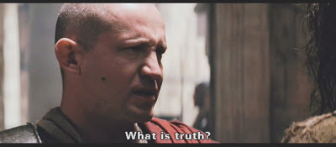
Pontius Pilate
John 18:38 – “Pilate said to Him, ‘What is truth?’”
John 14:6 – “I am the way, and the truth, and the life; no one comes to the Father but through Me.”
John 8:31-32 – “So Jesus was saying to those Jews who had believed Him, ‘If you continue in My word, then you are truly disciples of Mine; and you will know the truth, and the truth will make you free.’”

Slide 39
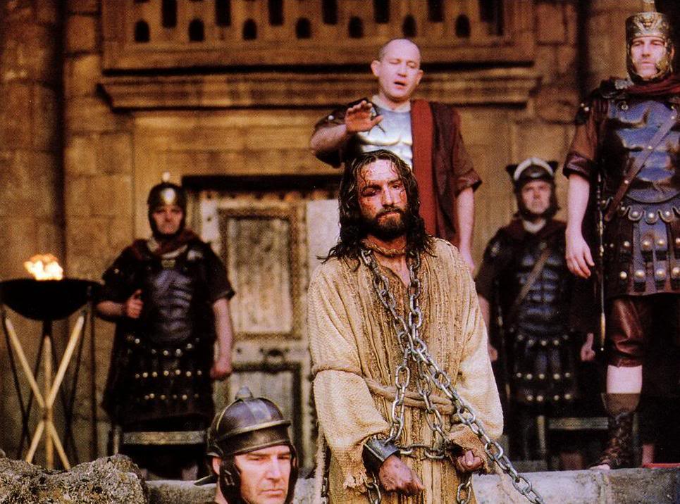
Pontius Pilate
John 18:38b – “And when he had said this, he went out again to the Jews and said to them, ‘I find no guilt in Him.’”
Accusation
Inquiry
Judgment

Slide 40
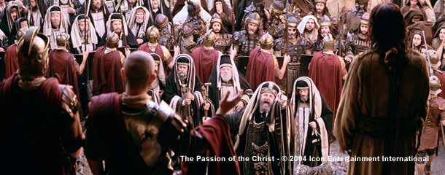
Pontius Pilate
Luke 23:5 – “But they kept on insisting, saying, ‘He stirs up the people, teaching all over Judea, starting from Galilee even as far as this place.’”

Slide 41
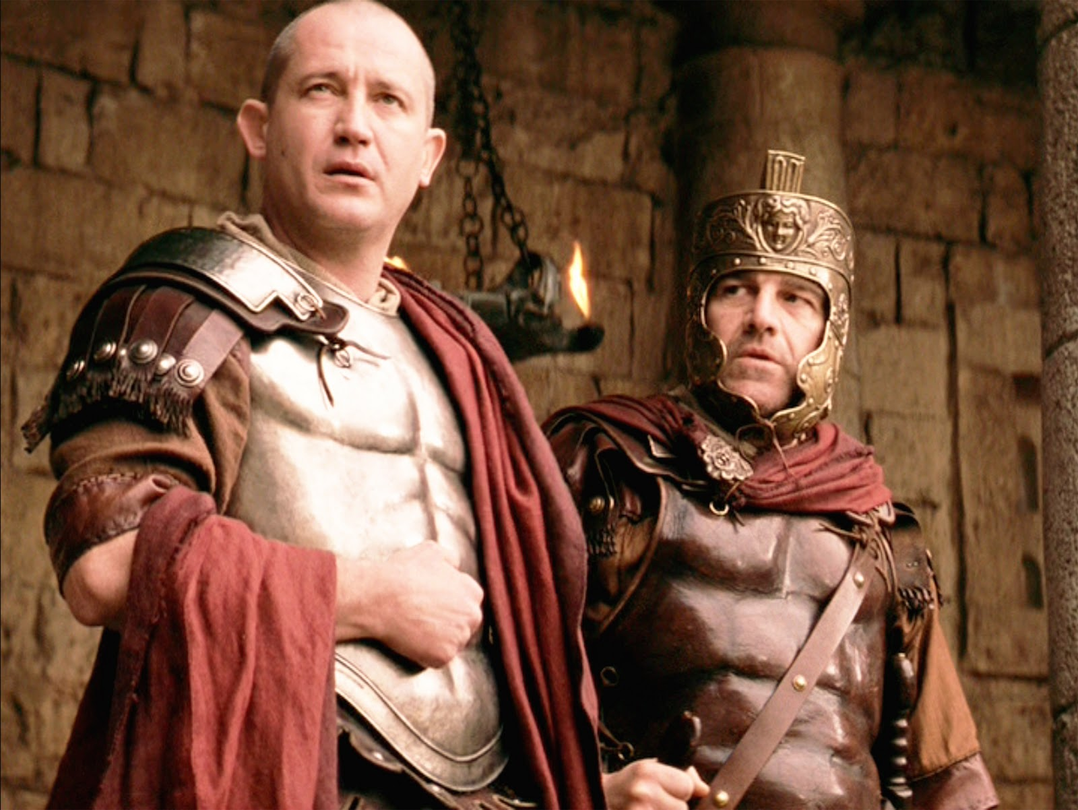
Pontius Pilate
Luke 23:6-7 – “When Pilate heard it, he asked whether the man was a Galilean. And when he learned that He belonged to Herod’s jurisdiction, he sent Him to Herod, who himself also was in Jerusalem at that time.”

Slide 42
Antipater
Herod the Great
(Matt 2:1-19)
Mariamme I
(Jew/Hasmonean)
Mariamme II
(Jew/Priestly)
Malthace
(Samaritan)
Cleopatra
(Jew)
Aristobulus
Philip
(Mark 6:17)
Archelaus
(Matt 2:22)
Herod Antipas
(Mark 6:14-29; Luke 3:1; 23:6-12)
Philip
(Luke 3:1)
Herod Agrippa I
(Acts 12:1-4, 20-23)
Herodias
(Mark 6:14-29)
Bernice
(Acts 25:13)
Herod Agrippa II
(Acts 25:13-26:32)
Drusilla
(Acts 24:24)
Salome
(Mark 6:14-29)

Slide 43
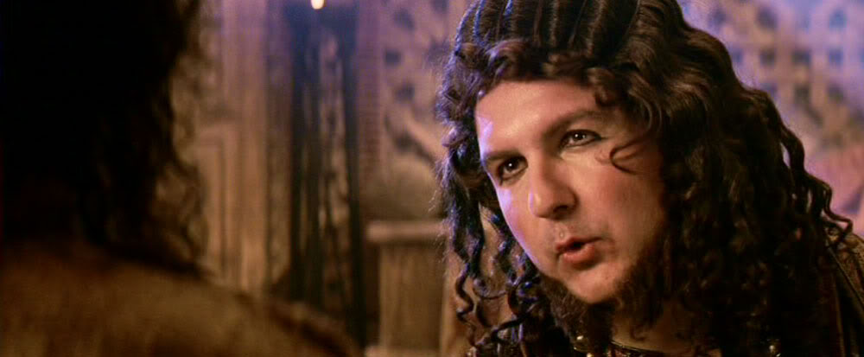
Herod Antipas
Luke 23:8 – “Now Herod was very glad when he saw Jesus; for he had wanted to see Him for a long time, because he had been hearing about Him and was hoping to see some sign performed by Him.”

Slide 44
Herod Antipas
Luke 23:9 – “And he questioned Him at some length; but He answered him nothing.”
Luke 23:10 – “And the chief priests and the scribes were standing there, accusing Him vehemently.”

Slide 45
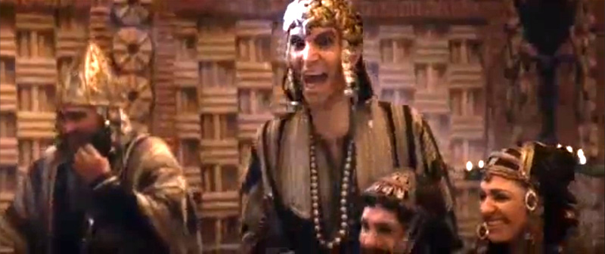
Herod Antipas
Luke 23:11 – “And Herod with his soldiers, after treating Him with contempt and mocking Him, dressed Him in a gorgeous robe and sent Him back to Pilate.”
Luke 23:12 – “Now Herod and Pilate became friends with one another that very day; for before they had been enemies with each other.”

Slide 46
Pontius Pilate
Luke 23:13-15 – “Pilate summoned the chief priests and the rulers and the people, and said to them, ‘You brought this man to me as one who incites the people to rebellion, and behold, having examined Him before you, I have found no guilt in this man regarding the charges which you make against Him. No, nor has Herod, for he sent Him back to us; and behold, nothing deserving death has been done by Him.’”

Slide 48
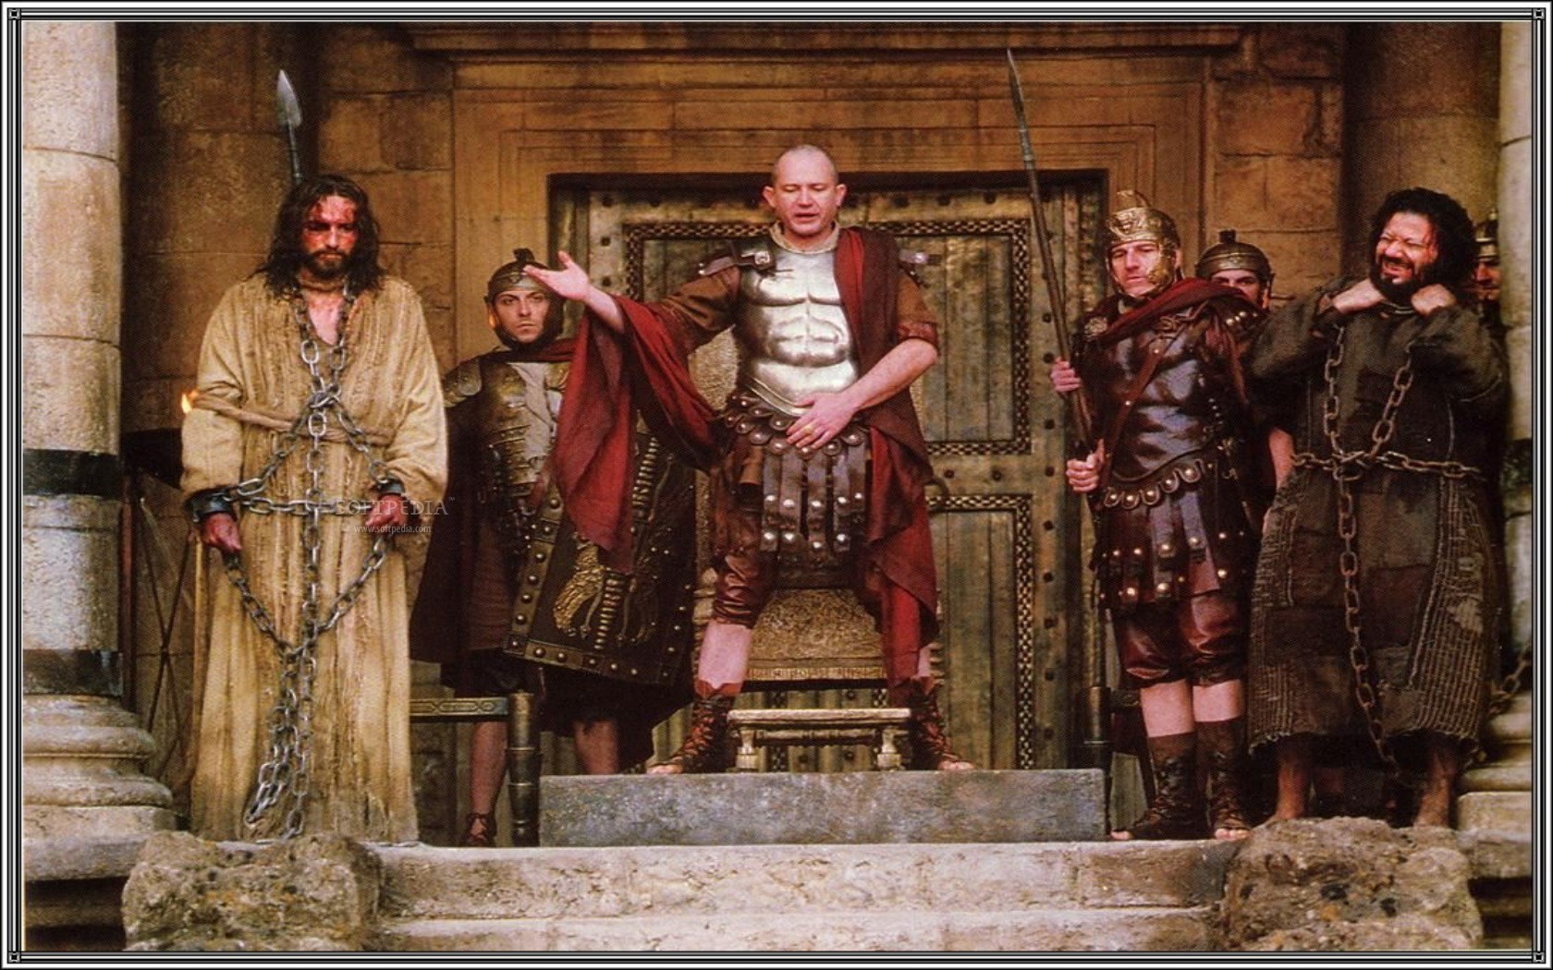
Pontius Pilate
John 18:39 – “But you have a custom that I release someone for you at the Passover; do you wish then that I release for you the King of the Jews?”
Luke 23:18-19 – “But they cried out all together, saying, ‘Away with this man, and release for us Barabbas!’ (He was one who had been thrown into prison for an insurrection made in the city, and for murder.)”

Slide 49
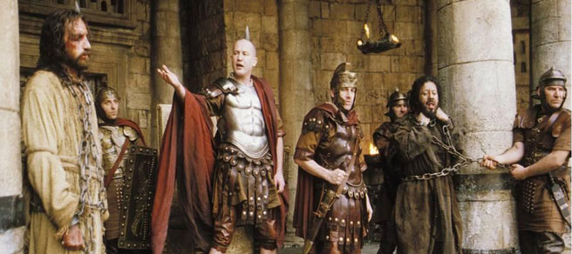
Pontius Pilate
Matt 27:22-23 – “Pilate said to them, ‘Then what shall I do with Jesus who is called Christ?’ They all said, ‘Crucify Him!’ And he said, ‘Why, what evil has He done?’ But they kept shouting all the more, saying, ‘Crucify Him!’”

Slide 50
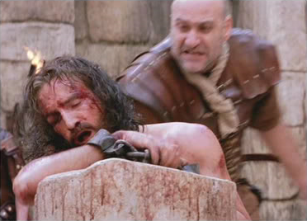
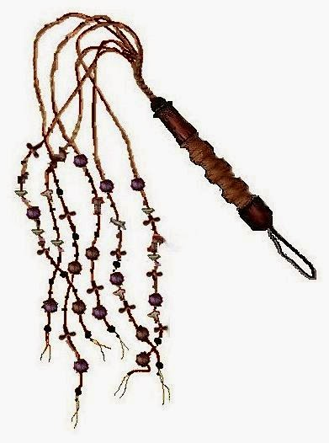
Pontius Pilate
John 19:1 – Pilate then took Jesus and scourged Him

Slide 51
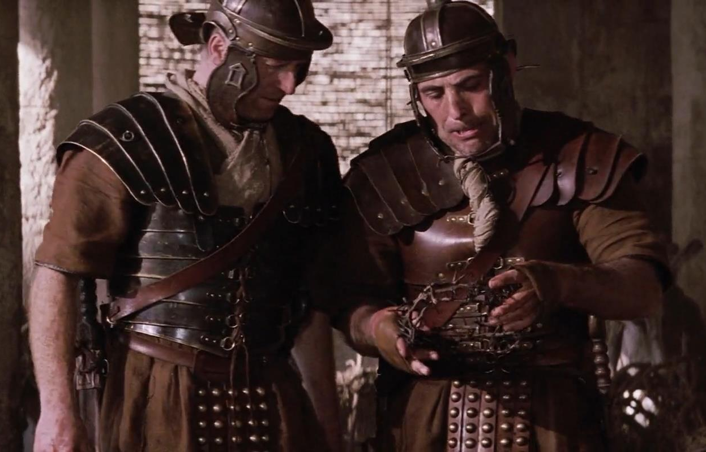
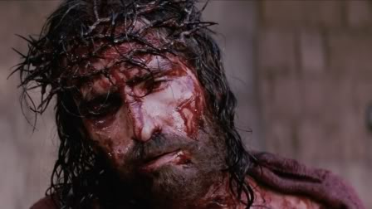
Pontius Pilate
John 19:2-5 – “And the soldiers twisted together a crown of thorns and put it on His head, and put a purple robe on Him; and they began to come up to Him and say, ‘Hail, King of the Jews!’ and to give Him slaps in the face. Pilate came out again and said to them, ‘Behold, I am bringing Him out to you so that you may know that I find no guilt in Him.’ Jesus then came out, wearing the crown of thorns and the purple robe. Pilate said to them, ‘Behold, the Man!”’

Slide 52
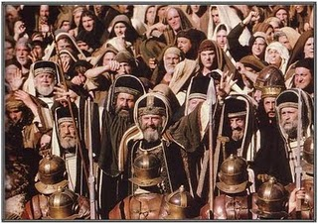
Pontius Pilate
John 19:6a – “So when the chief priests and the officers saw Him, they cried out saying, ‘Crucify, crucify!’”
John 19:6b – “Pilate said to them, ‘Take Him yourselves and crucify Him, for I find no guilt in Him.’”

Slide 53
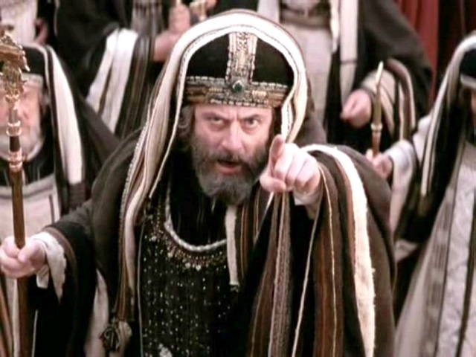
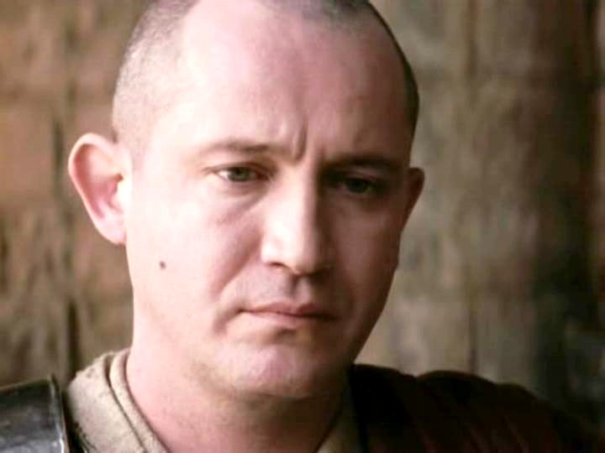
Pontius Pilate
John 19:7 – “The Jews answered him, ‘We have a law, and by that law He ought to die because He made Himself out to be the Son of God.’”
John 19:8 – “Therefore when Pilate heard this statement, he was even more afraid.”

Slide 54
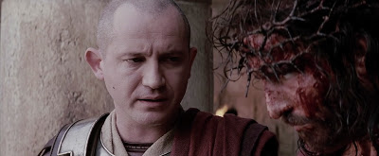
Pontius Pilate
John 19:9-10 – “And he entered into the Praetorium again and said to Jesus, ‘Where are You from?’ But Jesus gave him no answer. So Pilate said to Him, ‘You do not speak to me? Do You not know that I have authority to release You, and I have authority to crucify You?’”
John 19:11 – “Jesus answered, ‘You would have no authority over Me, unless it had been given you from above; for this reason he who delivered Me to you has the greater sin.’”

Slide 55
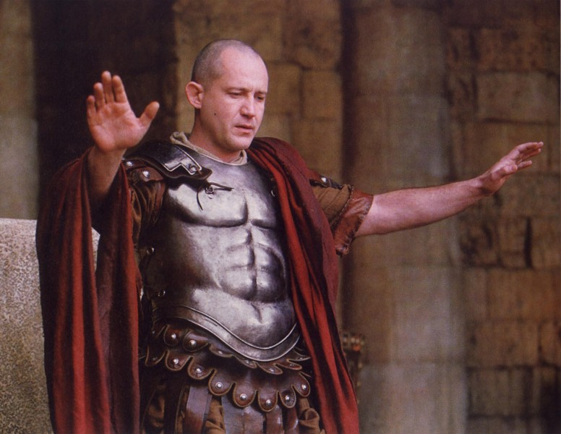
Pontius Pilate
John 19:12a – “As a result of this Pilate made efforts to release Him”
John 19:12b – “But the Jews cried out saying, ‘If you release this Man, you are no friend of Caesar; everyone who makes himself out to be a king opposes Caesar.’”

Slide 56
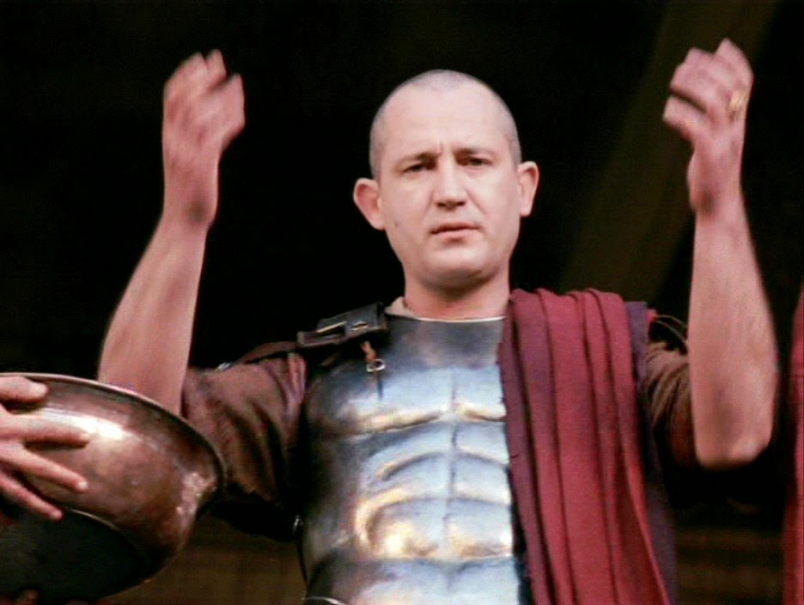
Pontius Pilate
Matt 27:24-25 – “When Pilate saw that he was accomplishing nothing, but rather that a riot was starting, he took water and washed his hands in front of the crowd, saying, ‘I am innocent of this Man’s blood; see to that yourselves.’ And all the people said, ‘His blood shall be on us and on our children!’”

Slide 57
Hebrew
Roman
Annas?
Guilty
Pilate?
Innocent
Caiaphas?
Guilty
Antipas?
Innocent
Sanhedin?
Guilty
Pilate?
Innocent

Slide 58
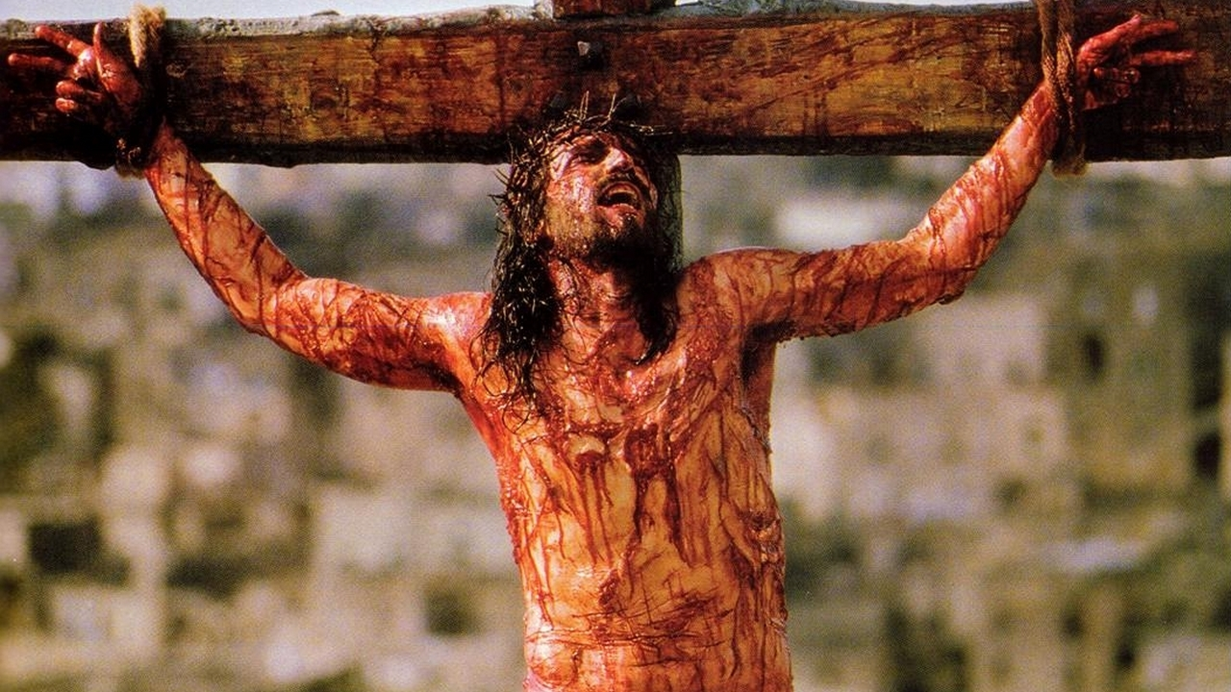
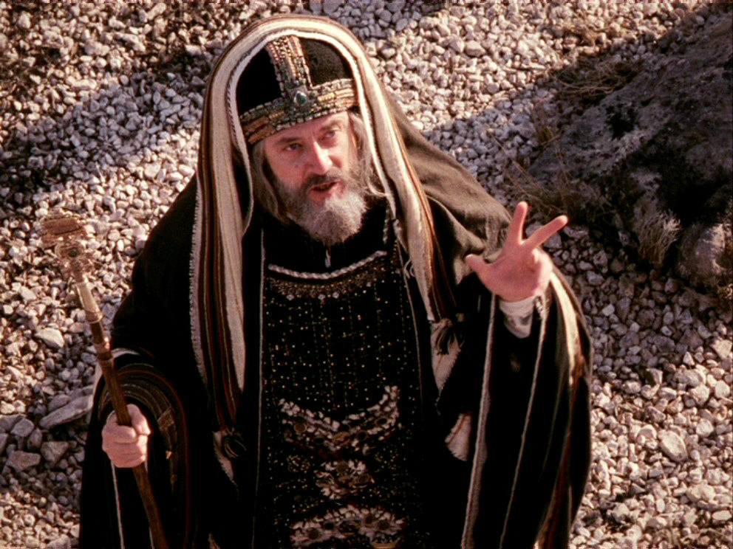
John 1:11 – “He came to His own, and those who were His own did not receive Him.”
William Blackstone – “It is better that ten guilty persons escape than that one innocent suffer.”
1 Pet 3:18a – “For Christ also died for sins once for all, the just for the unjust, so that He might bring us to God…”

