Slide 1
Eyes that look are common…
Eyes that see are rare…
j. Oswald Sander

Slide 3
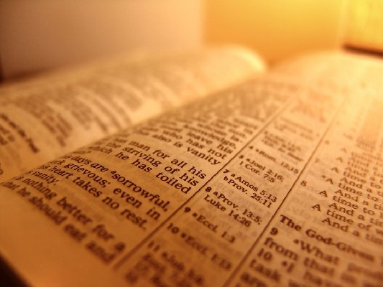
Truth and Tradition
I will Not Preach to you Baptism !

Slide 4
I will not preach…
DON’T PANIC!!! Baptism is ESSENTIAL to Salvation! (Mark 16:16 , Mathew 28 :16-20 , Galatians 3:27 ,1 Peter 3:21 etc..)
So are Belief ,Confession ,Repentance and Obedience…Acts 2:38
Why the focus on Baptism ?
“church of Christ “ doctrine?
Because Calvinism teaches “faith alone”?

Slide 5
Could we be AS wrong as THEY ARE?
YES WE COULD.

Slide 6
I will not preach…
… My Opinions ( 2 Corinthians 4:5 , Romans 11:25)
… Any other Gospel (Galatians 1:6-9 )
… Any other Doctrine ( 1 Timothy 6:3 ,1 John 1:10)
… Anything out of context (2 Peter 3:14-18 ,2 Timothy 4:3)
What then , MUST I preach of one is to be saved?
JESUS CHRIST and HIM CRUCIFIED
1 Corinthians 2:2

Slide 7
Simon and the Eunuch
Acts 8

Slide 8
Acts 8 – Simon
The men and women in Samaria believed the good news concerning the kingdom of God and the authority of Jesus Christ and were baptized.
Simon Magnus ,the magician also was amazed at Phillip’s teaching and he also was baptized.
This is congruent with Acts 2 (and other passages) that demonstrate when clearly that forgiveness of sins comes from God through baptism Following this , we see Simon fall..

Slide 9
Acts 8 – Simon
When Simon sees that the power of the Holy Spirit was given through the laying on of hands by the apostles, Simon offer to BUY this power..
Peter immediately rebukes Simon for believing that he could purchase the gift of God with money.
Peter further says that Simon is poisoned by bitterness and bound by iniquity.
Was Simon Saved? Was his baptism enough?

Slide 10
Acts 8 – The Eunuch
Same Teacher.
Same Gospel
Same urgent response – Immediate.
But clearly had a different reaction… Was the Eunuch saved? Was HIS Baptism enough?

Slide 11
Acts 8 – Simon and The Eunuch
The Answer to both questions is YES. Both Simon and the Eunuch were saved.
Both believed and obeyed the same Gospel , but had completely opposite reactions.
Simon quickly fell back into sin (vs.18)
The Eunuch went on his way rejoicing (vs.39)
How is this possible?
The HEART – You have neither part nor lot in this matter, for your heart is not right before God. Repent, therefore, of this wickedness of yours, and pray to the Lord that, if possible, the intent of your heart may be forgiven you. For I see that you are in the gall of bitterness and in the bond of iniquity.” (Acts 8:21-23 ESV)

Slide 12
The Heart of the Matter
Simon was a man who was full of himself – vs.9-11
Though he was taught and obeyed the Gospel , his heart was still in the world – not in Christ.
He had not yet died to self to live for Christ (Galatians 2:20)
He had NOT been “cut to the heart” like the Jews in Acts 2:37 at Pentecost.
By half heartedly stepping into a saved state , Simon demonstrates FULLY – that one CAN lose their Salvation…
But – there was yet HOPE…

Slide 13
The Heart of the Matter
Peter commanded Simon to repent in vs.22
“Pray for me” was Simon’s response..
This is not foreign to the scriptures either. (James 5:16)
This is also example of how one can be restored.
Finally , Godly sorrow MUST be part of the equation to produce REAL change…
Baptism without repentance just leaves someone wet…and dead in their sins

Slide 14
I will preach to you…
The Whole Council of God (Acts 20:27) The whole of God’s revelation, the balance of things, leaving nothing out of primary importance, never ducking the hard bits, helping believers to grasp the whole counsel of God that they themselves would become better equipped.
Jesus Christ and him crucified ( 1Corinthians 2:2) The best way to “cut to the heart” and produce the true repentance needed for change ,is putting it in personal perspective.
It was not only the Jews in Acts 2:36 who crucified Christ… It was also me…. And you.

Slide 15
I will preach to you…
To observe ALL that Christ commanded (Mathew 28:16-20)
If we preach the Whole Council of God , Christ Crucified , and Observation of ALL of Christ’s teaching – There is no doubt that Baptism is COVERED….
The focus MUST be on ones heart and the correct response to sound doctrine.
The heart MUST be led – and NOT followed (Jeremiah 17:9)
Simon followed his heart , rather than leading it (Acts 8:13) and nearly lost his soul…

Slide 16
I will not preach to you Baptism
But Rather the Whole Council of God

Slide 17
Truth and Tradition
I will Not Preach to you Baptism !

