Slide 1
Questions and Answers for the Mormon
“God our Savior, who desires all men to be saved and to come to the knowledge of the truth. For there is one God and one Mediator between God and men, the Man Christ Jesus, for who gave Himself a ransom for all” – 1 Timothy 2:4

Slide 2
Basic Beliefs
They are interested in God’s “newest revelation”
Majority are very religious (large temple worship, ceremonial)
They believe in Multiple Gods.
They worship Christ without really knowing Him
They do not believe in Salvation by the Grace of God

Slide 3
Athenians – Acts 17
They are interested in God’s “newest revelation”
Majority are very religious (large temple worship, ceremonial)
They believe in Multiple Gods.
They worship Christ without really knowing Him
They do not believe in Salvation by the Grace of God

Slide 4
“Paul reasoned with them”
Historical Errors
There is no evidence of Nephites and the Lamanites ever exisiting (1955 Thomas Ferguson)
Historical Truths
1 Kings 9:15 – “And this is the reason for the labor force which King Solomon raised: to build the house of the Lord, his own house, the Millo, the wall of Jerusalem, Hazor, Megiddo, and Gezer”

Slide 5
“Paul reasoned with them”
Historical Errors
Pre-Colombian technologies in the Americas
Cattle, sheep, swine, goats, wheat, barley, steel, brass
Historical Truths
Description of Goliath's armor (1 Samuel 14:4-6)
David kills a lion (1 Samuel 17:29)

Slide 6
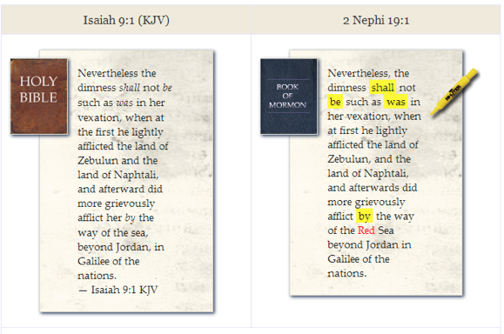
“Paul reasoned with them”

Slide 7
Who do you believe?
Example A
Forty authors, living in different times, tell you that God has spoken to them
Their books are harmonious, and they are full of historical and prophetic accuracies
Example B
One author tells you that God has spoken to him
His books are full of historical errors
Not Harmonious

Slide 8
Who do you believe?
Example A (The Holy Bible)
Forty authors, living in different times, tell you that God has spoken to them
Their books are harmonious, and they are full of historical and prophetic accuracies
Example B (The Writings of Joseph Smith)
One author tells you that God has spoken to him
His books are full of historical errors
Not Harmonious
“But I feel God is telling me that this is True”

Slide 9
Amazing Grace
Ephesian 2:8-9 “ ⁸ For by grace you have been saved through faith, and that not of yourselves; it is the gift of God, ⁹ not of works, lest anyone should boast.”
Romans 3:20-24 “²⁰ Therefore by the deeds of the law no flesh will be justified in His sight, for by the law is the knowledge of sin. ²¹ But now the righteousness of God apart from the law is revealed, being witnessed by the Law and the Prophets, ²² even the righteousness of God, through faith in Jesus Christ, to all and on all who believe. For there is no difference; ²³ for all have sinned and fall short of the glory of God, ²⁴ being justified freely by His grace through the redemption that is in Christ Jesus,”
John 1:14 “And the Word became flesh and dwelt among us, and we beheld His glory, the glory as of the only begotten of the Father, full of grace and truth.

