Slide 2
Small Changes are Big

Slide 3
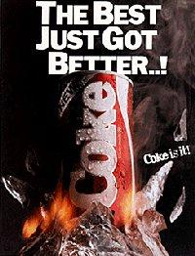
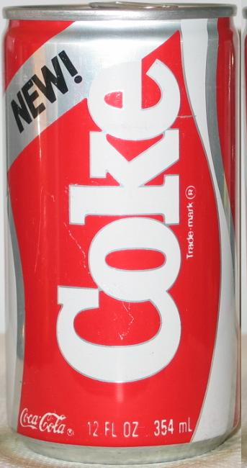

Slide 4
Small Changes are Big
The change of worship by Jeroboam. I Kings 11-12
Because of Solomon turning away from God, the kingdom would become divided.
Jeroboam made some terrible mistakes.

Slide 5
Small Changes are Big
The change of worship by worship by men today. I Kings 11-12
Many religious people have made small changes to God’s pattern of worship.
Many have decided that what the NT pattern is no longer effective for us today.

Slide 6
Small Changes are Big
Let us not be deceived by evil desires from the hearts of men.
If our worship is not what it needs to be, it’s not because of God, but us.

